Slide 1
Parallel Processing
CDA3101

Slide 2
Parallelism in Pipelining
Static multiple issue
Chosen at compile time
Dynamic multiple issue
Chosen at run time

Slide 3
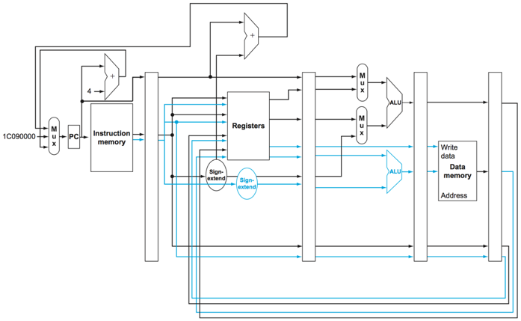
Static Multiple Issue Pipeline

Slide 4
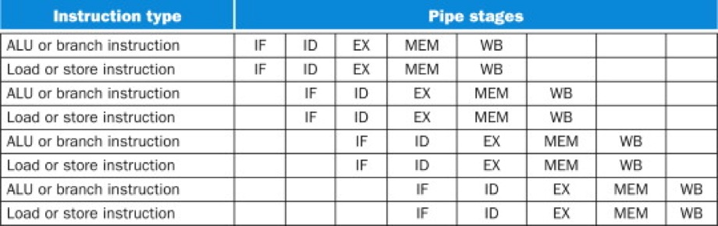
Static Multiple Issue Pipeline

Slide 5
Example Problem Step 1
add x2, x3, x4
stur x4, [x0, #8]
ldur x9, [x0, #4]
add x5, x2, x2
sub x7, x5, x2
cbz x2, #3

Slide 6
Example Problem Step 2
add x2, x3, x4
stur x4, [x0, #8]
ldur x9, [x0, #4]
add x5, x2, x2
sub x7, x5, x2
cbz x2, #3
Instruction | Cycle 1 | Cycle 2 | Cycle 3 | Cycle 4 | Cycle 5 | Cycle 6 | Cycle 7 | Cycle 8
add x2, x3, x4 | IF
stur x4, [x0, #8] | IF
 |  |  |  |  |  |  |  | WB

Slide 7
Example Problem Step 3
add x2, x3, x4
stur x4, [x0, #8]
ldur x9, [x0, #4]
add x5, x2, x2
sub x7, x5, x2
cbz x2, #3
Instruction | Cycle 1 | Cycle 2 | Cycle 3 | Cycle 4 | Cycle 5 | Cycle 6 | Cycle 7 | Cycle 8
add x2, x3, x4 | IF | ID
stur x4, [x0, #8] | IF | ID
ldur x9, [x0, #4] |  | IF
add x5, x2, x2 |  | IF
 |  |  |  |  |  |  |  | WB

Slide 8
Example Problem Step 4
add x2, x3, x4
stur x4, [x0, #8]
ldur x9, [x0, #4]
add x5, x2, x2
sub x7, x5, x2
cbz x2, #3
Instruction | Cycle 1 | Cycle 2 | Cycle 3 | Cycle 4 | Cycle 5 | Cycle 6 | Cycle 7 | Cycle 8
add x2, x3, x4 | IF | ID | EX
stur x4, [x0, #8] | IF | ID | EX
ldur x9, [x0, #4] |  | IF | ID
add x5, x2, x2 |  | IF | ID
sub x7, x5, x2 |  |  | IF

Slide 9
Example Problem Step 5
add x2, x3, x4
stur x4, [x0, #8]
ldur x9, [x0, #4]
add x5, x2, x2
sub x7, x5, x2
cbz x2, #3
Instruction | Cycle 1 | Cycle 2 | Cycle 3 | Cycle 4 | Cycle 5 | Cycle 6 | Cycle 7 | Cycle 8
add x2, x3, x4 | IF | ID | EX | MEM | WB
stur x4, [x0, #8] | IF | ID | EX | MEM | WB
ldur x9, [x0, #4] |  | IF | ID | EX | MEM | WB
add x5, x2, x2 |  | IF | ID | EX | MEM | WB
sub x7, x5, x2 |  |  | IF | ID | EX | MEM | WB
cbz x2, #3 |  |  |  | IF | ID | EX | MEM | WB

Slide 10
Example Problem 2 Step 1
add x1, x3, x4
stur x1, [x0, #8]
ldur x2, [x0, #4]
add x5, x2, x2
sub x7, x5, x2
cbz x7, #3

Slide 11
Example Problem 2 Step 2
add x1, x3, x4
stur x1, [x0, #8]
ldur x2, [x0, #4]
add x5, x2, x2
sub x7, x5, x2
cbz x7, #3
Can’t put these in a multiple issue packet because of dependency

Slide 12
Example Problem 2 Step 3
add x1, x3, x4
ldur x2, [x0, #4]
add x5, x2, x2
stur x1, [x0, #8]
sub x7, x5, x2
cbz x7, #3
Rearrange the stur since nothing depends on it

Slide 13
Example Problem 2 Step 4
add x1, x3, x4
ldur x2, [x0, #4]
add x5, x2, x2
stur x1, [x0, #8]
sub x7, x5, x2
cbz x7, #3
Suitable packet
Rearrange the stur since nothing depends on it

Slide 14
Example Problem 2 Step 5
add x1, x3, x4
ldur x2, [x0, #4]
add x5, x2, x2
stur x1, [x0, #8]
sub x7, x5, x2
cbz x7, #3
Suitable packet, but with a dependency, will need a stall
Rearranging will do no good, because sub has the same dependency

Slide 15
Example Problem 2 Step 6
add x1, x3, x4
ldur x2, [x0, #4]
add x5, x2, x2
stur x1, [x0, #8]
sub x7, x5, x2
cbz x7, #3
Instruction | Cycle 1 | Cycle 2 | Cycle 3 | Cycle 4 | Cycle 5 | Cycle 6 | Cycle 7 | Cycle 8 | Cycle 9
add x1, x3, x4 | IF | ID
ldur x2, [x0, #4] | IF | ID
add x5, x2, x2 |  | IF
stur x1, [x0, #8] |  | IF

Slide 16
Example Problem 2 Step 7
add x1, x3, x4
ldur x2, [x0, #4]
add x5, x2, x2
stur x1, [x0, #8]
sub x7, x5, x2
cbz x7, #3
Instruction | Cycle 1 | Cycle 2 | Cycle 3 | Cycle 4 | Cycle 5 | Cycle 6 | Cycle 7 | Cycle 8 | Cycle 9
add x1, x3, x4 | IF | ID | EX
ldur x2, [x0, #4] | IF | ID | EX
add x5, x2, x2 |  | IF | ID
stur x1, [x0, #8] |  | IF | ID
sub x7, x5, x2 |  |  | IF

Slide 17
Example Problem 2 Step 8
add x1, x3, x4
ldur x2, [x0, #4]
add x5, x2, x2
stur x1, [x0, #8]
sub x7, x5, x2
cbz x7, #3
Instruction | Cycle 1 | Cycle 2 | Cycle 3 | Cycle 4 | Cycle 5 | Cycle 6 | Cycle 7 | Cycle 8 | Cycle 9
add x1, x3, x4 | IF | ID | EX | MEM
ldur x2, [x0, #4] | IF | ID | EX | MEM
add x5, x2, x2 |  | IF | ID | ID
stur x1, [x0, #8] |  | IF | ID | ID
sub x7, x5, x2 |  |  | IF | IF

Slide 18
Example Problem 2 Step 9
add x1, x3, x4
ldur x2, [x0, #4]
add x5, x2, x2
stur x1, [x0, #8]
sub x7, x5, x2
cbz x7, #3
Instruction | Cycle 1 | Cycle 2 | Cycle 3 | Cycle 4 | Cycle 5 | Cycle 6 | Cycle 7 | Cycle 8 | Cycle 9
add x1, x3, x4 | IF | ID | EX | MEM | WB
ldur x2, [x0, #4] | IF | ID | EX | MEM | WB
add x5, x2, x2 |  | IF | ID | ID | EX | MEM | WB
stur x1, [x0, #8] |  | IF | ID | ID | EX | MEM | WB
sub x7, x5, x2 |  |  | IF | IF | ID | EX | MEM | WB
cbz x7, #3 |  |  |  |  | IF | ID | EX | MEM | WB
Packet needs to stall together so the fetch happens together

Slide 19
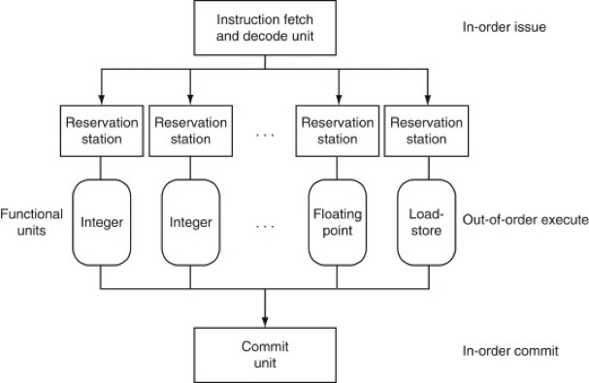
Dynamic Multiple Issue

Slide 20
Dynamic Multiple Issue
add x1, x3, x4
stur x1, [x0, #8]
ldur x2, [x0, #4]
add x5, x2, x2
sub x7, x5, x2
cbz x7, #3

Slide 21
Dynamic Multiple Issue
add x1, x3, x4
stur x1, [x0, #8]
ldur x2, [x0, #4]
add x5, x2, x2
sub x7, x5, x2
cbz x7, #3
add x1, x3, x4
stur x1, [x0, #8]

Slide 22
Dynamic Multiple Issue
add x1, x3, x4
stur x1, [x0, #8]
ldur x2, [x0, #4]
add x5, x2, x2
sub x7, x5, x2
cbz x7, #3
ldur x2, [x0, #4]
add x1, x3, x4
stur x1, [x0, #8]

Slide 23
Dynamic Multiple Issue
add x1, x3, x4
stur x1, [x0, #8]
ldur x2, [x0, #4]
add x5, x2, x2
sub x7, x5, x2
cbz x7, #3
ldur x2, [x0, #4]
sub x7, x5, x2
cbz x7, #3
add x1, x3, x4
add x5, x2, x2
stur x1, [x0, #8]

Slide 24
Dynamic Multiple Issue
add x1, x3, x4
stur x1, [x0, #8]
ldur x2, [x0, #4]
add x5, x2, x2
sub x7, x5, x2
cbz x7, #3
sub x7, x5, x2
cbz x7, #3
add x5, x2, x2
stur x1, [x0, #8]
add x1, x3, x4
ldur x2, [x0, #4]

Slide 25
Dynamic Multiple Issue
add x1, x3, x4
stur x1, [x0, #8]
ldur x2, [x0, #4]
add x5, x2, x2
sub x7, x5, x2
cbz x7, #3
sub x7, x5, x2
cbz x7, #3
add x5, x2, x2
stur x1, [x0, #8]
ldur x2, [x0, #4]
add x1, x3, x4

Slide 26
Dynamic Multiple Issue
add x1, x3, x4
stur x1, [x0, #8]
ldur x2, [x0, #4]
add x5, x2, x2
sub x7, x5, x2
cbz x7, #3
cbz x7, #3
sub x7, x5, x2
add x5, x2, x2
stur x1, [x0, #8]
ldur x2, [x0, #4]
add x1, x3, x4

Slide 27
Dynamic Multiple Issue
add x1, x3, x4
stur x1, [x0, #8]
ldur x2, [x0, #4]
add x5, x2, x2
sub x7, x5, x2
cbz x7, #3
sub x7, x5, x2
add x5, x2, x2
ldur x2, [x0, #4]
cbz x7, #3
stur x1, [x0, #8]
add x1, x3, x4

Slide 28
Dynamic Multiple Issue
add x1, x3, x4
stur x1, [x0, #8]
ldur x2, [x0, #4]
add x5, x2, x2
sub x7, x5, x2
cbz x7, #3
cbz x7, #3
sub x7, x5, x2
add x5, x2, x2
ldur x2, [x0, #4]
stur x1, [x0, #8]
add x1, x3, x4

Slide 29
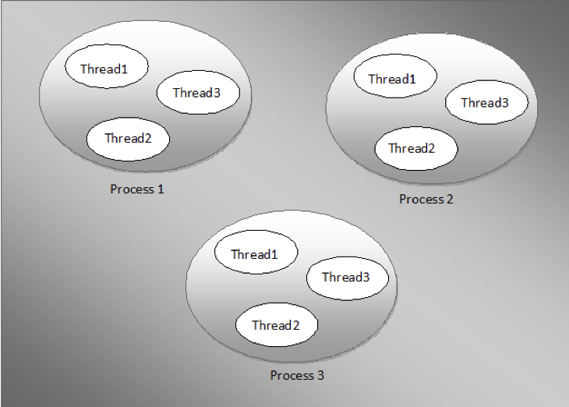
Multi-threading
Performing multiple threads of execution in parallel
Fast switching between threads

Slide 30
Threads vs. Processes
Process
A program in execution
Memory is not shared
Switching requires interacting with operating system
Thread
Part of a process
Memory is shared
Switching does not require interacting with operating system
Has its own state and registers

Slide 31
Multi-threading
In dynamic multiple issue processor
Schedule instructions from multiple threads
Instructions from independent threads execute when functional units available
Within threads, dependencies handled by scheduling and register renaming

Slide 32
Example Problem 3 Step 1
Assume we have two threads X and Y that include the following operations.
How many cycles will it take to execute these two threads on a two core processor that allows out of order execution.

Slide 33
Example Problem 3 Step 2
Assume we have two threads X and Y that include the following operations.
How many cycles will it take to execute these two threads on a two core processor that allows out of order execution.
Core 1 | Core 2
A3 | B2
A1 | B1
A1 | B1
A1 | B4
A2 | B4
A4 | B3

Slide 34
Example Problem 4 Step 1
Assume we have two threads X and Y that include the following operations.
How many cycles will it take to execute these two threads on a two core processor that allows out of order execution. Each core has two functional units.

Slide 35
Example Problem 4 Step 2
Assume we have two threads X and Y that include the following operations.
How many cycles will it take to execute these two threads on a two core processor that allows out of order execution. Each core has two functional units.
Core 1 | Core 2
A3, A2 | B2, B4
A1 | B1, B4
A1, A4 | B1, B3
A1

Slide 36
Example Problem 5 Step 1
Assume we have two threads X and Y that include the following operations.
How many cycles will it take to execute these two threads on a processor that has a processor that has two functional units that allows instructions from two threads to be run concurrently, though only instructions from a single thread can be issued on any cycle.

Slide 37
Example Problem 5 Step 2
Assume we have two threads X and Y that include the following operations.
How many cycles will it take to execute these two threads on a processor that has a processor that has two functional units that allows instructions from two threads to be run concurrently, though only instructions from a single thread can be issued on any cycle.
FU1 | FU2
A3 | A2
 | A1
 | A1
A4 | A1
B2 | B4
B1 | B4
B1 | B3

Slide 38
Example Problem 6 Step 1
Assume we have two threads X and Y that include the following operations.
How many cycles will it take to execute these two threads on a processor that has a processor that has two functional units that allows instructions from two threads to be run concurrently, and instructions different threads can be issued on any cycle.

Slide 39
Example Problem 6 Step 2
Assume we have two threads X and Y that include the following operations.
How many cycles will it take to execute these two threads on a processor that has a processor that has two functional units that allows instructions from two threads to be run concurrently, and instructions different threads can be issued on any cycle.
FU1 | FU2
A3 | A2
B2 | A1
B1 | A1
B1 | A1
A3 | B4
B3 | B4

Slide 40
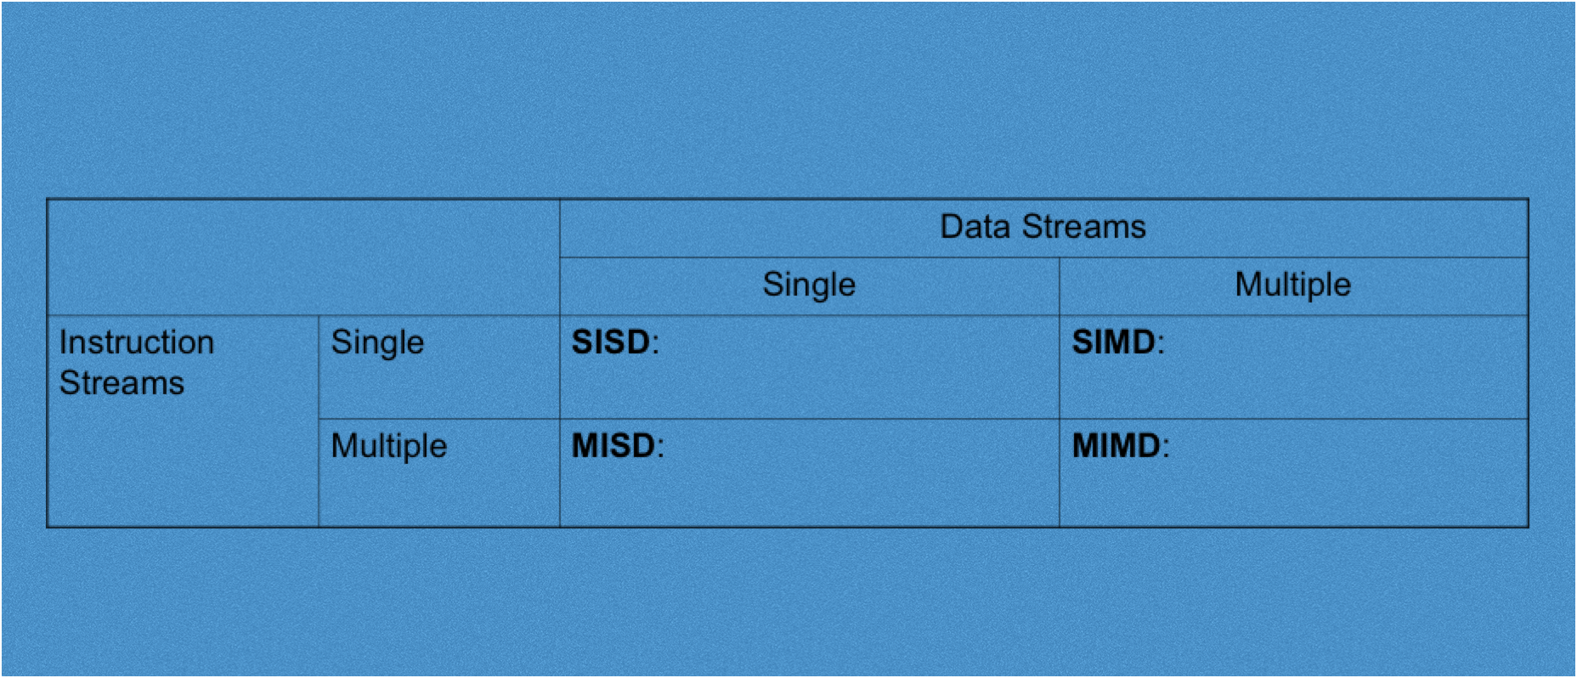
Flynn’s Taxonomy

Slide 41
Flynn’s Taxonomy
One processor, one data path for a single instruction

Slide 42
Flynn’s Taxonomy
Vector processing – same operation on a vector of values.
Handled with vector instructions and registers.

Slide 43
Flynn’s Taxonomy
No “processor” that does this. But fault tolerance and having multiple computers operating on the same data could fall into this category

Slide 44
Flynn’s Taxonomy
Single program, multiple data
Shared memory processing

Slide 45
Flynn’s Taxonomy
Single program, multiple data
multiple processors networked together to accomplish a task

Slide 46
Flynn’s Taxonomy
Shared memory processing
multiple cores
threading
single physical address space for all processors

Slide 47
Shared Memory Processing - UMA

Slide 48
Shared Memory Processing - NUMA

Slide 49
Example Problem 7 Step 1
A shared memory processing system has 4 processors. A program consists of a section that must be executed sequentially and requires 10 ns. The remainder of the program can be parallelized and requires 90 ns. What is the speedup obtained when running this program on 4 processors?

Slide 50
Example Problem 7 Step 2
A shared memory processing system has 4 processors. A program consists of a section that must be executed sequentially and requires 10 ns. The remainder of the program can be parallelized and requires 90 ns. What is the speedup obtained when running this program on 4 processors?
Non parallel processing time: 100 ns
Parallel processing time: 10 + 90/4 = 32.5 ns
Speedup = 100/32.5 = 3.08

Slide 51
Example Problem 8 Step 1
If I have 10 processors, what fraction of a program must be parallelizable in order to get a speedup of 5?

Slide 52
Example Problem 8 Step 2
If I have 10 processors, what fraction of a program must be parallelizable in order to get a speedup of 5?
5 = 1/(F/10 + (1-F))
5*(F/10 + (1-F) = 1
F/2 + 5(1-F) = 1
F + 10 – 10F = 2

